Slide 1
Joshua Burden
DSC530 Data Exploration
Term Project

Slide 2
Dataset
The dataset used is https://www.kaggle.com/toramky/automobile-dataset/version/2
The data consists of three different types of entities:
Specification of auto in terms of various characteristics
Assigned insurance risk rating
Normalized losses in use as compared to other cars

Slide 3
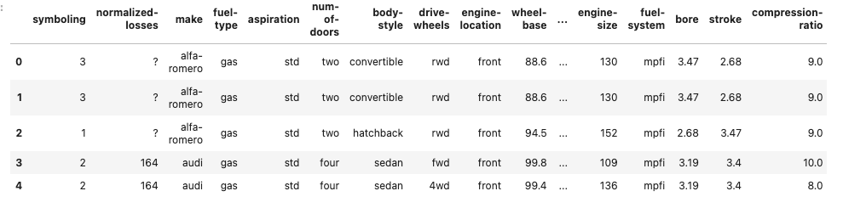
Minimum of 5 variables in your dataset used during your analysis

Slide 4
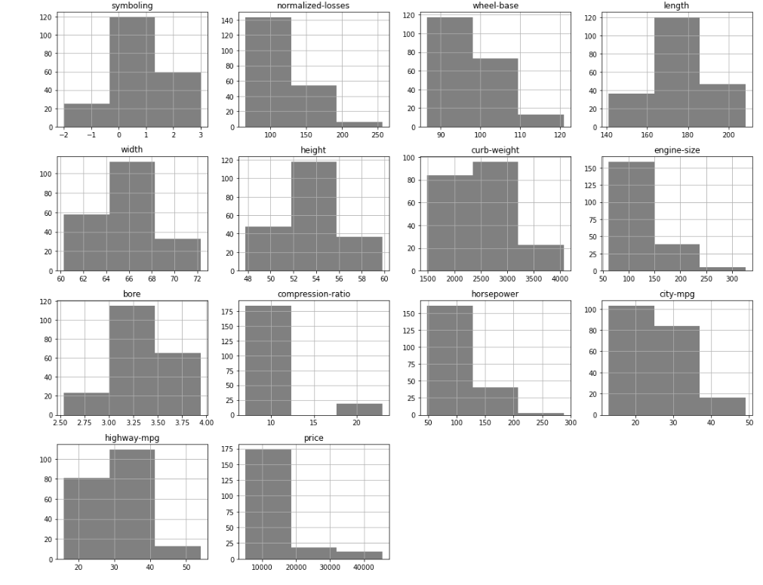
Include a histogram with 5 variables

Slide 5
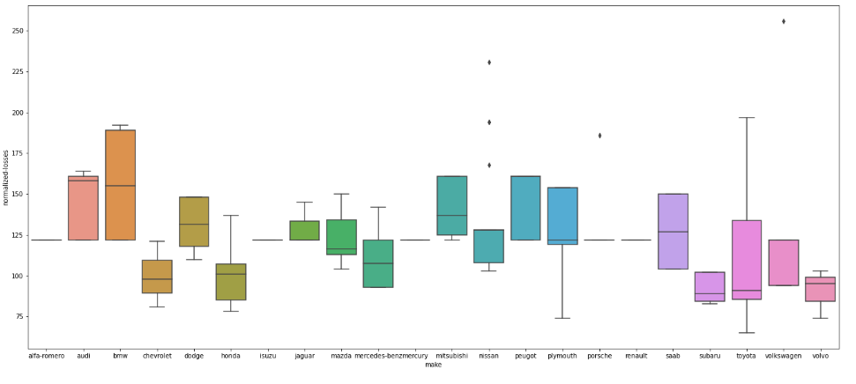
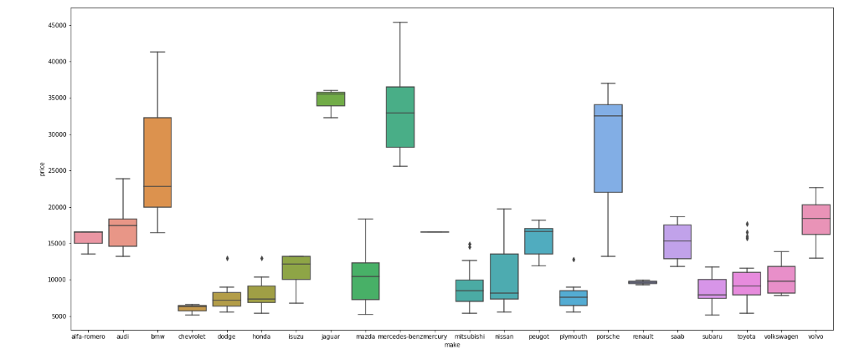
Using page 29 of your text as example, compare two scenarios in your data using PMF

Slide 6
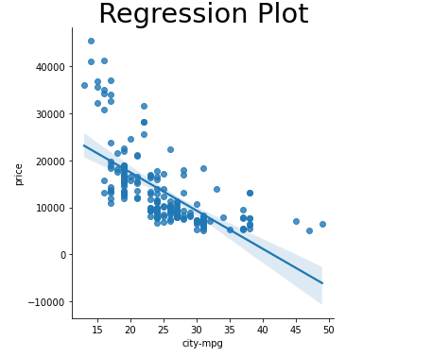
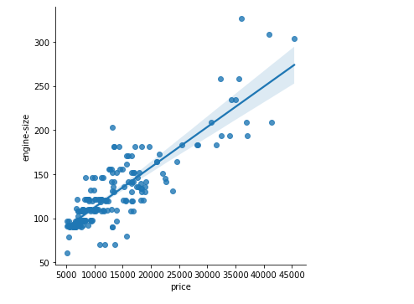
Create two scatterplots comparing two variables

Slide 7
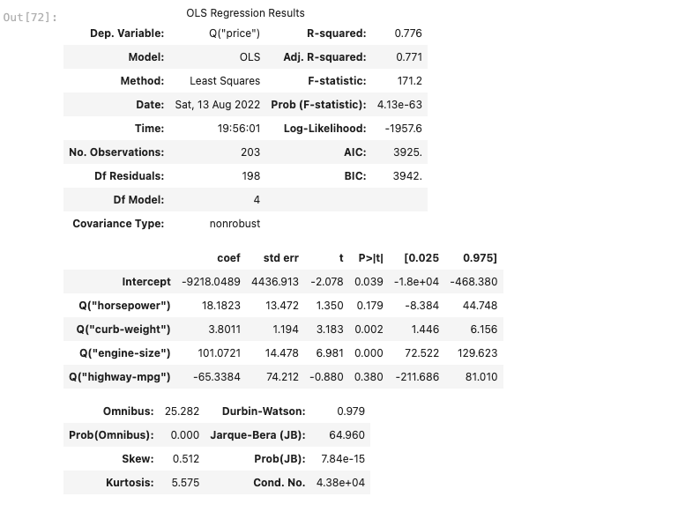
For this project conduct a regression analysis on either one dependent and one explainatory variable

